Slide 1
Cleaning and Transforming the Data
housing_sample_clean.xlsx

Slide 2
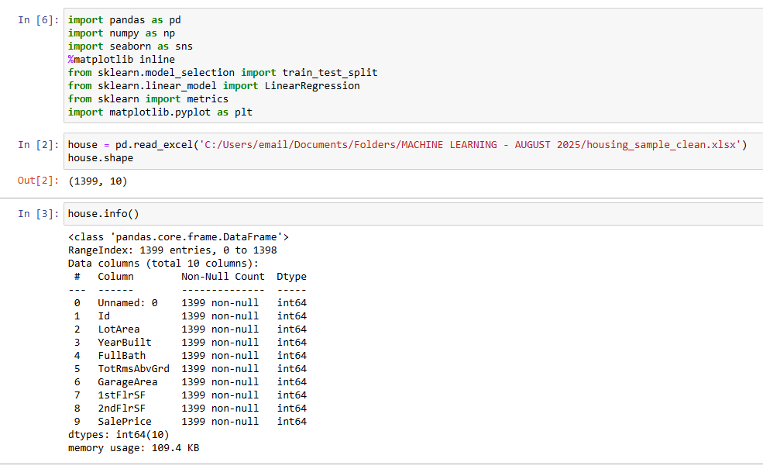
Python Libraries
The dataframe contains 1399 rows (observations) and 10 columns (variables)
No missing values in the dataset

Slide 3
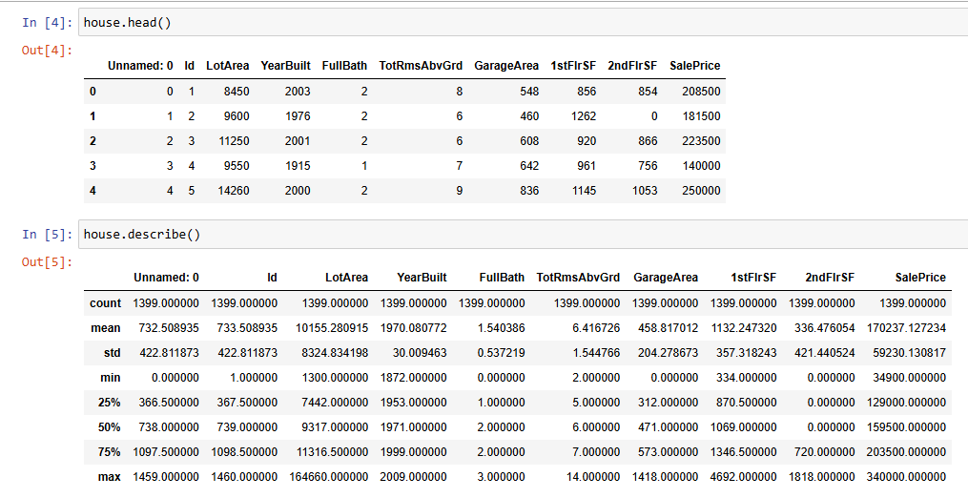
Exploring the Data

Slide 4
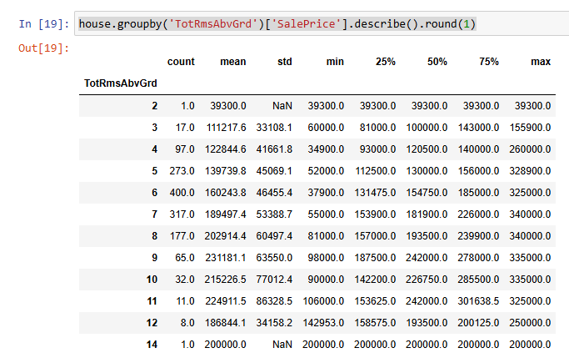
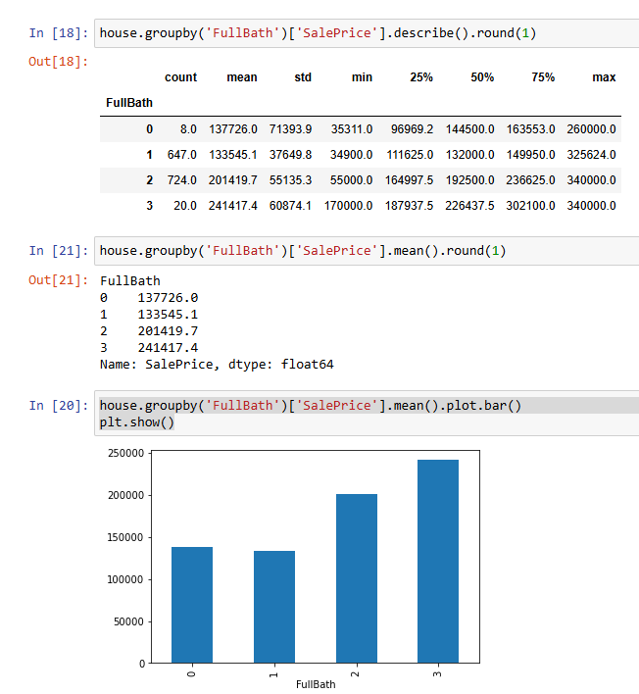
Graphical Representation of FullBath and TotRmsAbvGrd
The more bathrooms are in the house the higher the price for the house
Though, there is no much difference between 0 and 1 FullBath
There is only 8 houses with the FullBath = 0
So, we can combine this group with the FullBath = 1
For the TotRmsAbvGrd above 9 there is no rise in the SalePrice (the median
goes down)

Slide 5
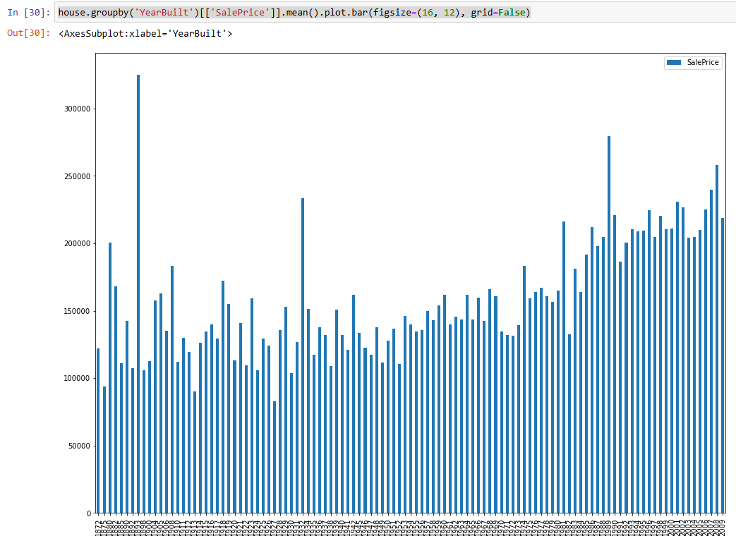
Exploring the SalePrice by the YearBuilt with mean

Slide 6
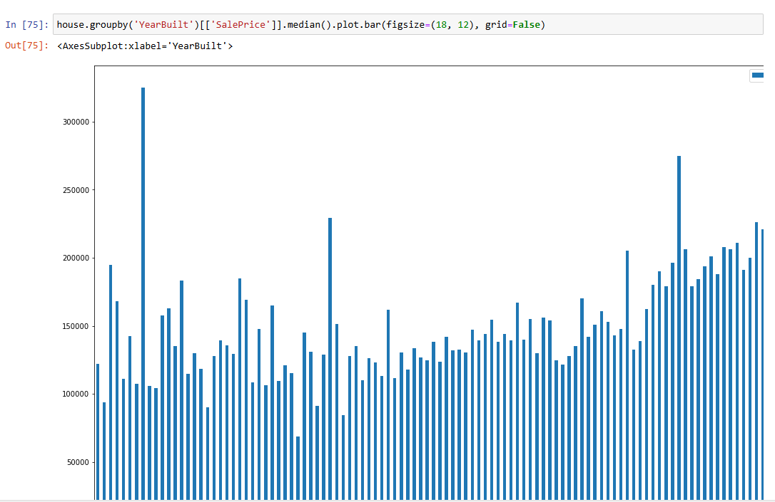
Exploring the SalePrice by the YearBuilt with median
Both graphs show that there are three
years in which the sales were higher than
the rest of the houses in the same period time

Slide 7
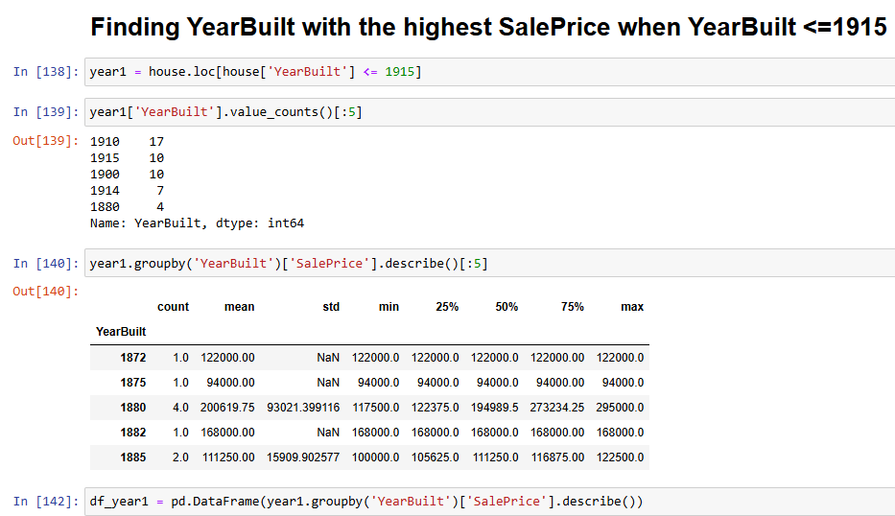
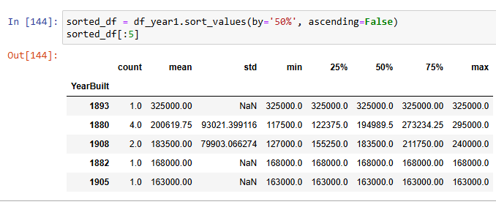
Creating three groups of time YearBuilt <=1915
For further exploration of the sales price over the years, we create three chanks of time: before 1915, 1916 – 1960, after 1960
There is one house in the 1893 which median SalePrice is higher ($325000)
compared to other houses built in the same period of time

Slide 8
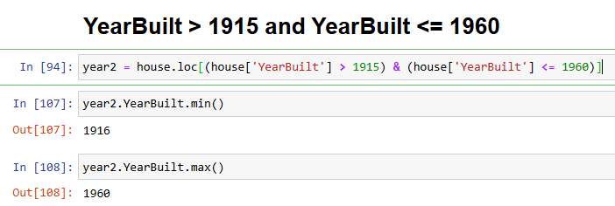
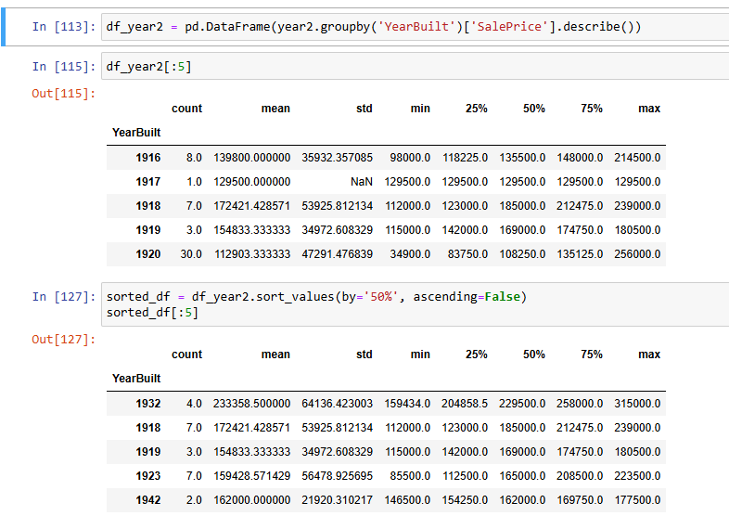
YearBuilt between 1915 and 1960
There are 4 houses in 1932 who’s median SalePrice ($229500)
Is higher compared to other houses built in the same period of time

Slide 9
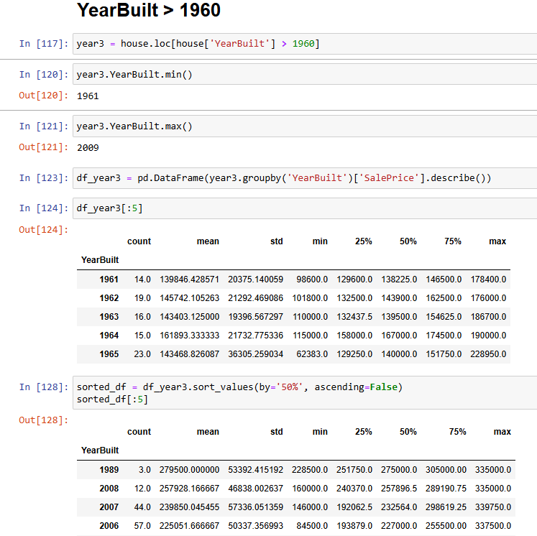
YearBuilt after 1960
There are 3 houses in 1989 who’s 75% quantile SalePrice ($305000)
Is higher compared to other houses in the same period of time
So, there are three years – 1893 (1 house), 1932
(4 houses), and 1989 (3 houses) in which the SalePrice was
higher compared to other properties built in the same period of time

Slide 10
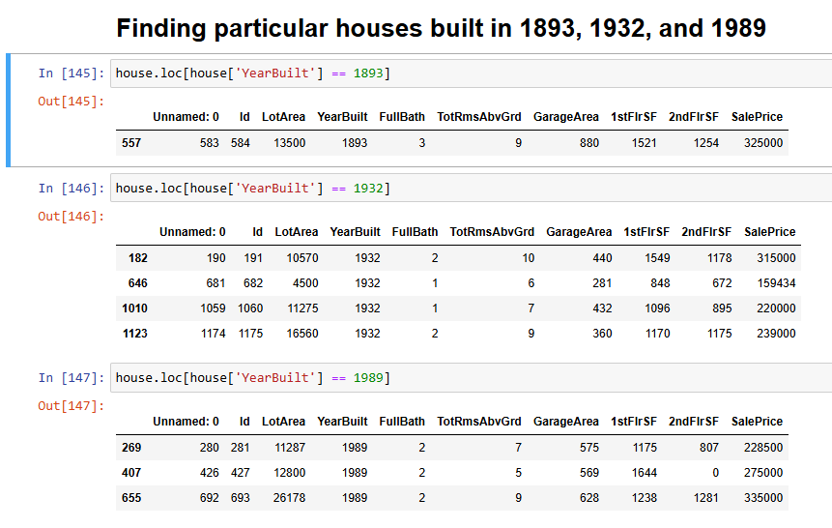
Further Exploration of the houses in 1893, 1932, and 1989
The ID’s of the houses with the highest
SalePrice are 557 ($325000), 182 ($315000),
and 655 ($335000)
We are going to remove these
three houses from the data

Slide 11
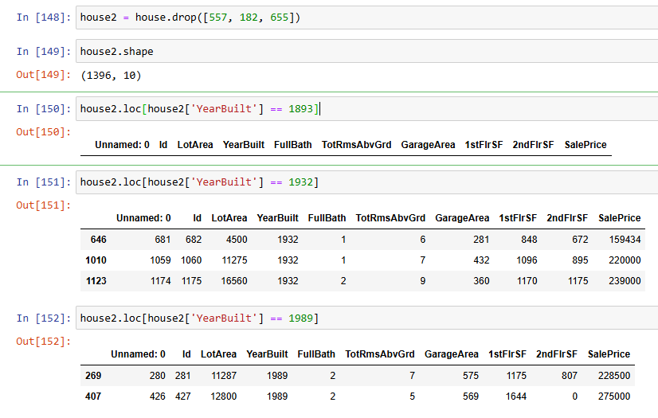
Removing the rows by ID
The number of rows in the data frame
reduced from 1399 to 1396
There is no more houses
with ID’s 557, 182, 655 in the dataset

Slide 12
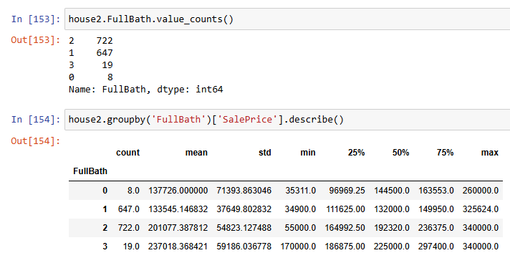
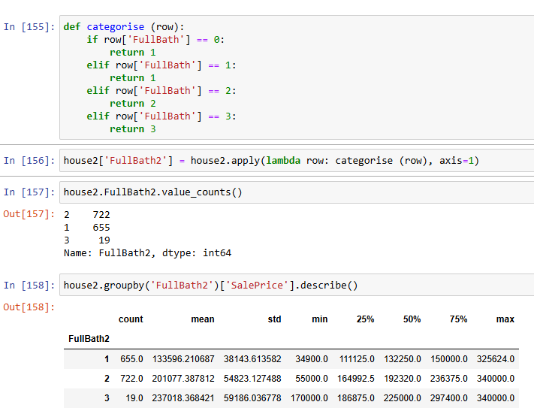
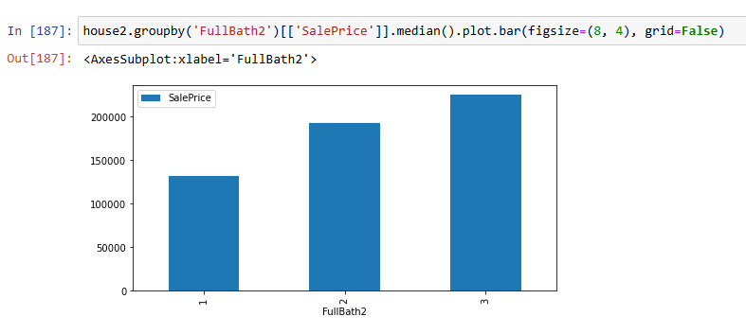
Transforming FullBath into a new variable with three categories

Slide 13
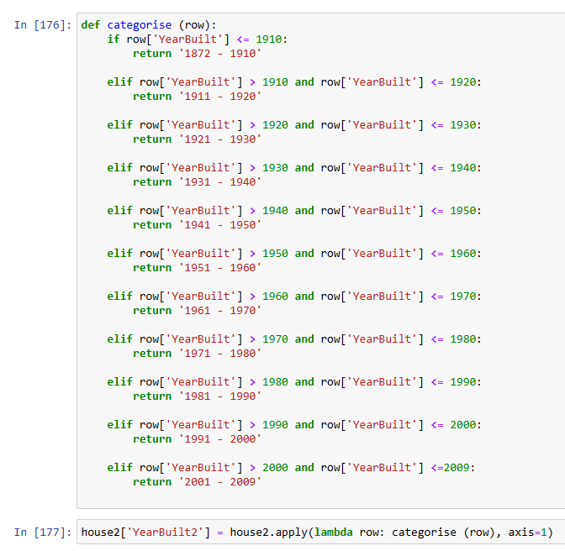
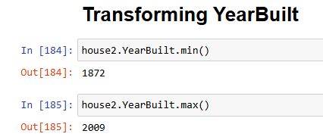
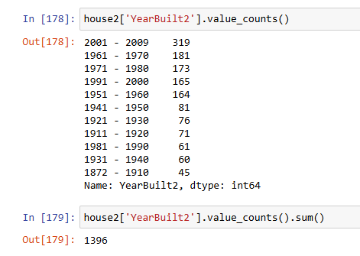
Transforming YearBuilt variable

Slide 14
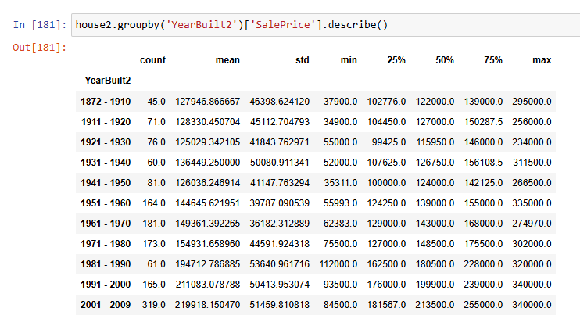
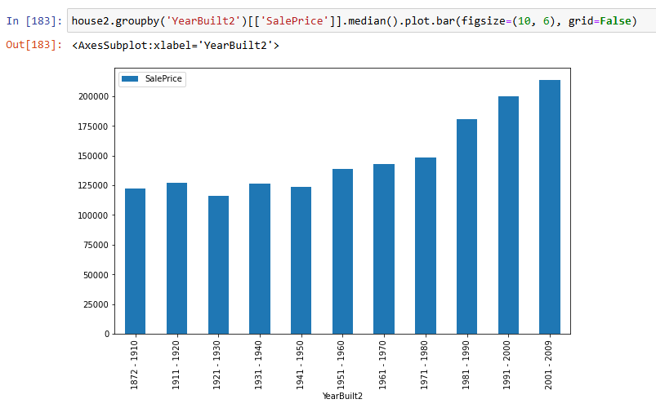
SalePrice by YearBuilt2

